Slide 1
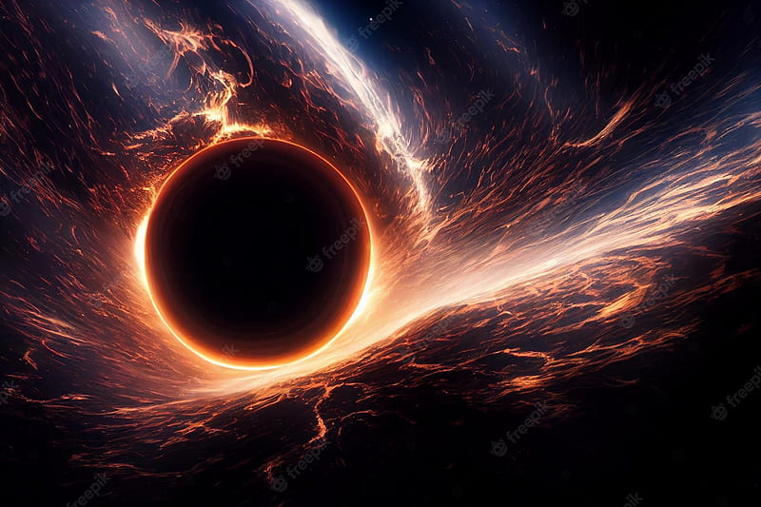
Celestial Enigmas; Black Holes
Aun Anis 24P-3017 BSE-2A

Slide 2
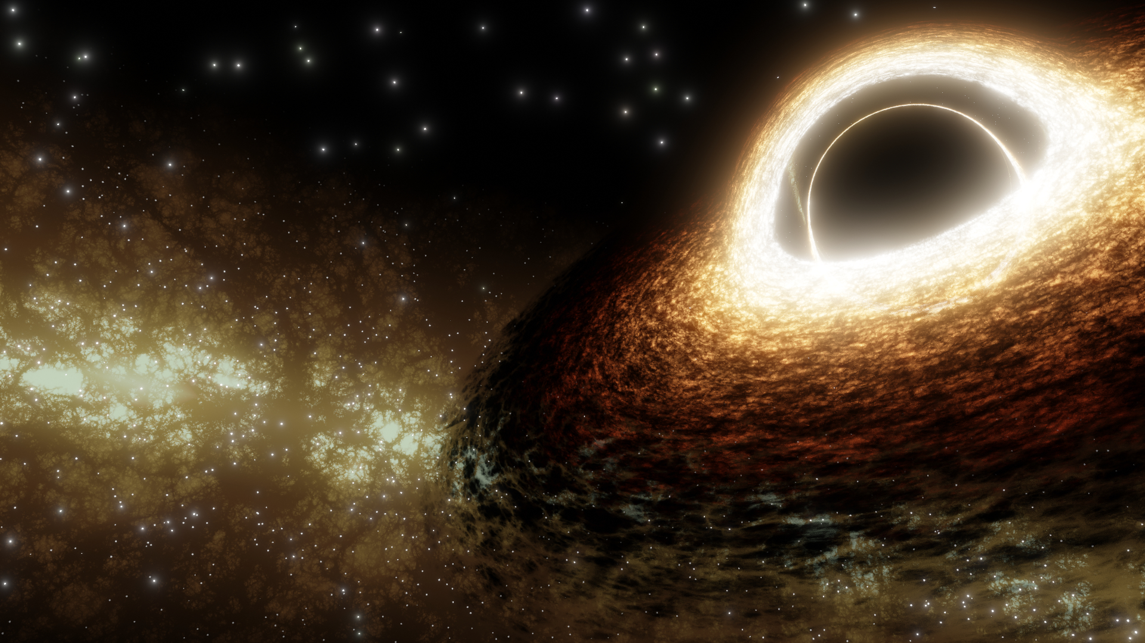
What is a Black Hole?
A black hole is an astronomical object with a gravitational pull so strong that nothing, not even planets or light itself, can escape it.

Slide 3
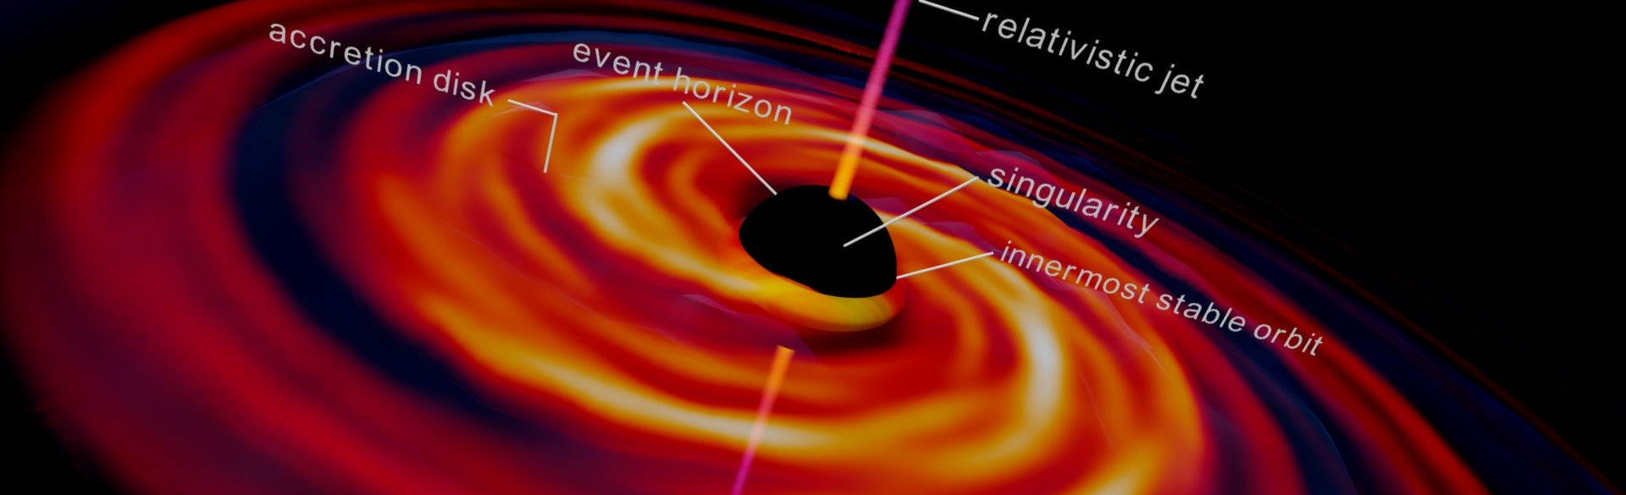
Parts of a Black Hole:
Singularity: The very center of a black hole, a place where matter is compressed down to an infinitely tiny point, and all conceptions of time and space completely break down.
Event Horizon: The "surface" of the black hole. The point of no return, here the velocity needed to escape the black hole exceeds the speed of light.
Accretion Disk: The main source of light from the black hole.

Slide 4
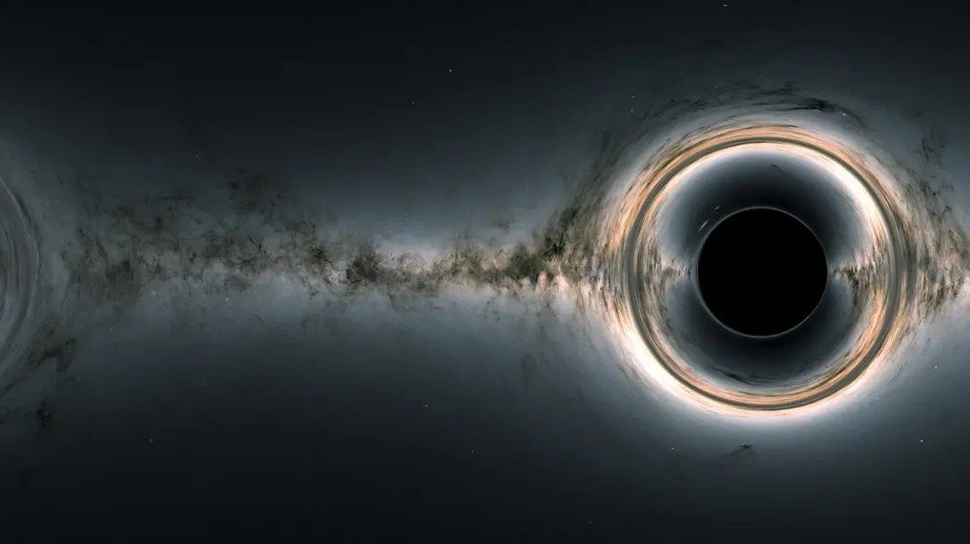
Types of Black Holes:
Stellar-mass Black Holes: Created when massive stars explode, leaving behind a black hole with the mass of just a few suns.
Intermediate-mass Black Holes: Such bodies form when stars collide in a chain reaction and usually contain the mass equivalent to hundreds and thousands of suns.
Supermassive Black Holes: Exist in the hearts of galaxies and usually contain the mass equivalent to millions and billions of suns.

Slide 5
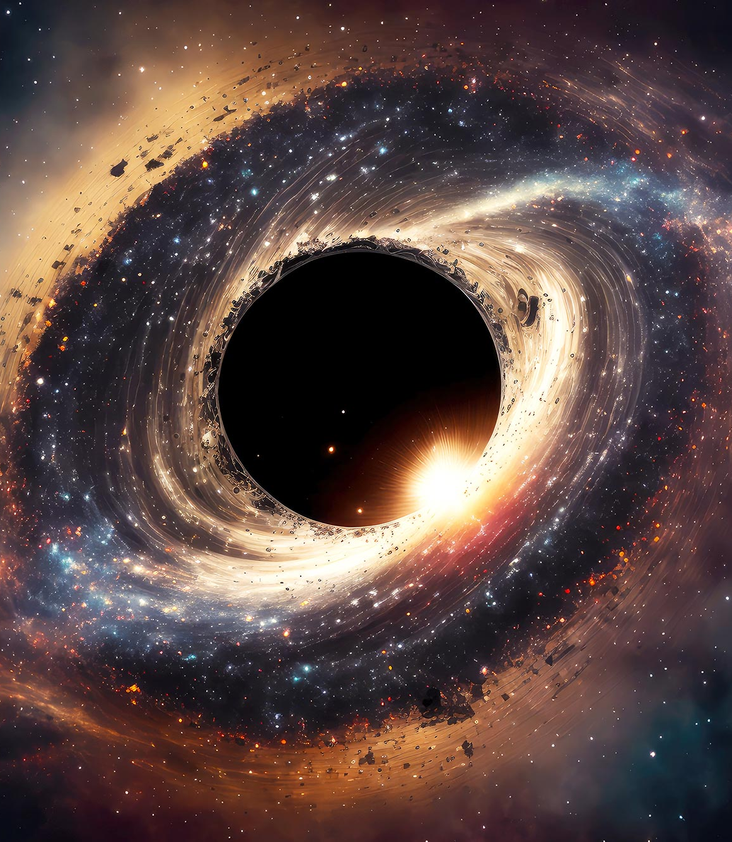
Facts about Black Holes:
Once formed, a black hole cannot die.
Since no light can escape, a black hole cannot be seen by the naked eye.
Black Holes cannot be captured by a camera, scientists at NASA capture images of black holes through a network of telescopes known as the Event Horizon Telescope (EHT).
A Black Hole with a mass similar to planet Earth would be the size of a fingernail.

Slide 6
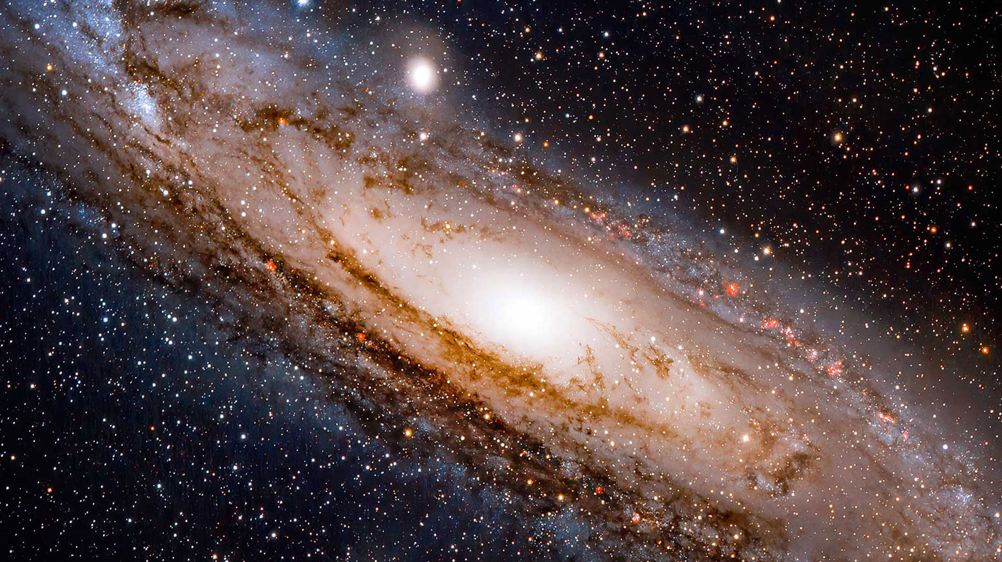
Thank You for Listening!
Most of the information for this presentation has been taken from: https://www.nasa.gov/universe/

